Slide 1
Computer Organization Theory Name: Ganesh Oli Student Id num: M19W7387

Slide 2
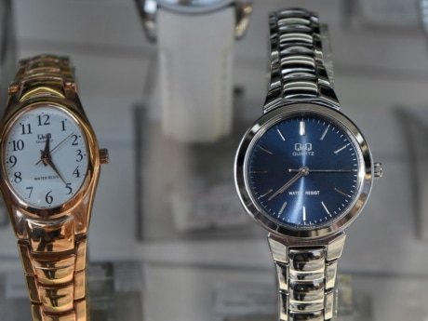
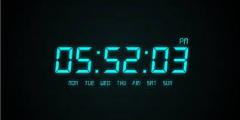
Topic | What I came to know about the given topic from my research?
Clock | It is the instrument which is used to measure, keep and indicate the time which helps to about the time so that the daily works can be completed in the desired period. There are many types of clock for example analogue clock, digital clock, electronic wood clock, auditory clock, tactile clock, multi display clock which we are using in our lives.
Analogue Clock | It is the type of clock which is usually in the 12 hours format which has usually hours, minutes and second hands. Hours hand usually make 2 revolution in a day where as minute hand make the one revolution per hour and the second hand make the revolution every minute. The common example of the analogue clock is the common watch which we usually wear in the hand.
Digital Clock | It is another type of clock which has the different function than that of analogue clock. Analogue clock usually display 12 hours format but the digital clock display both 24 hours notation and 12 hours notation with AM/PM indicator. In today’s world digital clock is replacing the analogue clock.
Fig: Analogue Clock Fig: Digital Clock

Slide 3

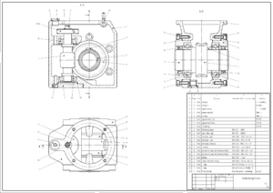

Topic | What I came to know about the given topic from my research?
Animation | Animation is the method in which pictures are manipulated to appear in the moving images. It uses the hydrotechnics which includes light, water, fire fog and many others which can be viewed through the high definition on the mist screen through projectors. Nowadays many movies and programs are made by using the animation.
CAD (Computer Aided Design) | It the use of computers to aid in the creation, modification , analysis or optimizing the design. It is the software which helps to increase the productivity of designer, improvement in the quality of design, and create the database for manufacturing. CAD is used to create the curves and figures in 2D and 3D. It is also used in animation to give the special effects.
MAYA | It is software which is 3D computer graphics which is developed by Alias Systems Corporation. It is software which is used in to create the 3D assets in movie, television, game development and architecture.
Fig: Animated Movie Fig: 2D figure using CAD Fig: Picture by MAYA

Slide 4
Topic | What I came to know about the given topic from my research?
Browser | It is the application which is used to access the information from world wide web. Browsing can be done by the help of Chrome, Firefox, Safari and so on. We can get the necessary information from browsing in the easy manner through web.
Cache | It is the type of memory in which data are stored for specific time by which we can get the required data in the short interval of time. The type of cache are browser cache, memory cache, processor cache and disk cache. All of these cache have the same properties in their specific field to throw the requested data in short time.
Cookies | A cookie is a small amount of data generated by a website and saved by your web browser. Its purpose is to remember information about you, similar to a preference file created by a software application. Whenever you check a box that says, "Remember me on this computer," the website will generate a login cookie once you successfully log in. Each time you revisit the website, you may only need to enter your password or you might not need to log in at all.

Slide 5
Topic | What I came to know about the given topic from my research?
Driver | Device Driver is a computer program that control or operates a particular type of device attached to the computer. It provides a software interface to hardware devices. Drivers are hardware dependent and operating system specific. Driver interface with the devices such as printer, sound card, video card and so on which are attached with the computer.
Firewall | Firewall is a network security system that monitors and controls incoming and outgoing network traffic based on predetermined security rules. A firewall typically establishes a barrier between a trusted internal network and untrusted external network, such as the Internet. Firewalls are often categorized as either network firewalls or host-based firewalls. Network firewalls filter traffic between two or more networks and run on network hardware. Host-based firewalls run on host computers and control network traffic in and out of those machines.
Ethernet | Ethernet is a component of computer networking technologies commonly used in local area networks, metropolitan area networks and wide area networks. It was commercially introduced in 1980 and first standardized in 1983 as IEEE 802.3. Ethernet is widely used in homes and industry. The Internet Protocol is commonly carried over Ethernet and so it is considered one of the key technologies that make up the Internet.

Slide 6
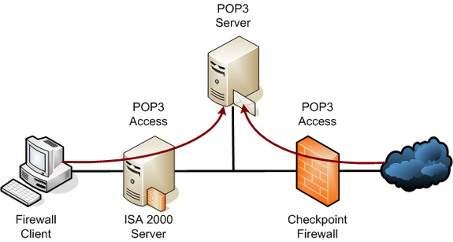
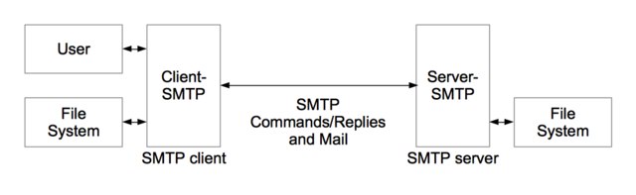
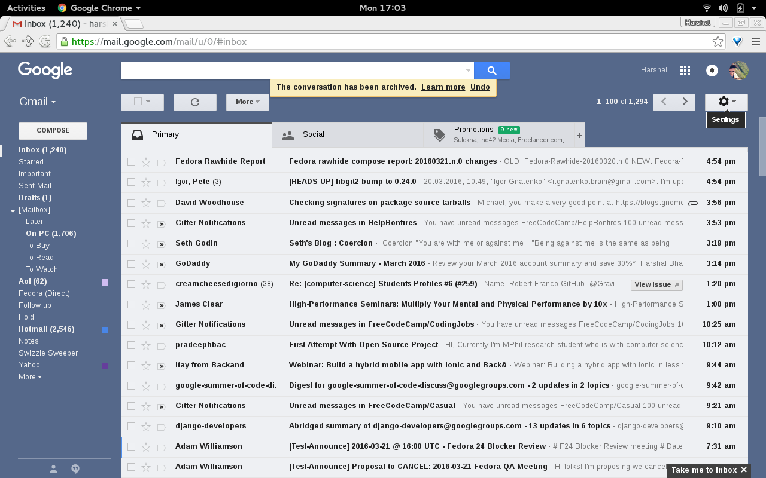
Topic | What I came to know about the given topic from my research?
POP3 (Post Office Protocol 3) | It is the most recent version of standard protocol used to for receiving e-mails from the Internet server. This protocol is built in most popular email products. POP3 clients connect, retrieve all messages, store them on the client computer, and finally delete them from the server.
SMTP (Simple Mail Transfer Protocol) | It is a communication protocol for electronic mail transmission. As an Internet standard, SMTP was first defined in 1982 by RFC 821, and updated in 2008 by RFC 5321 to Extended SMTP additions, which is the protocol variety in widespread use today. It is just opposite to POP because SMTP helps to send the emails whereas POP helps to retrieve the emails.
Email | Electronic mail is a method of exchanging messages between people using electronic devices. It is the new way for the communication and also the easy way for transferring the messages. Email address can be created by using the different email providers like Gmail, Yahoo mail, Outlook and so on.
Fig: POP3 Fig: SMTP Fig: E-mail

Slide 7
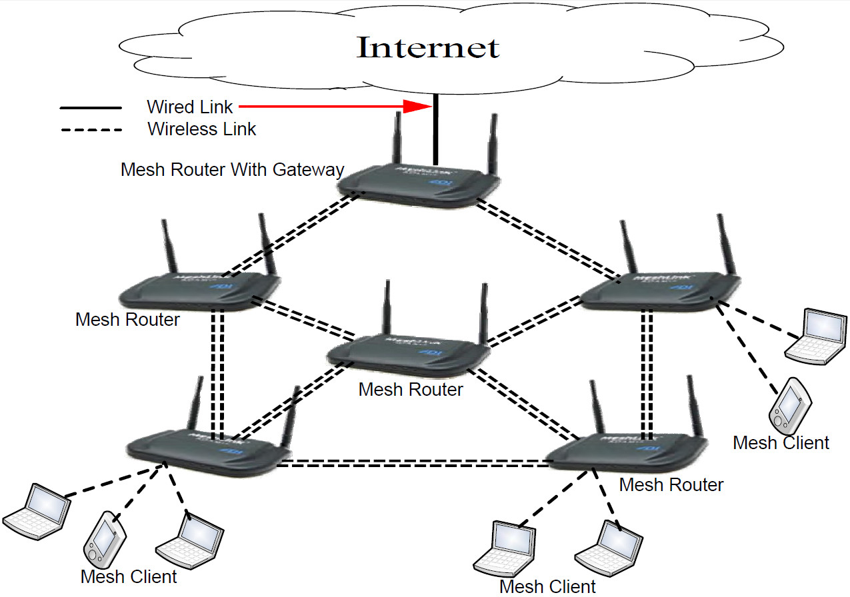
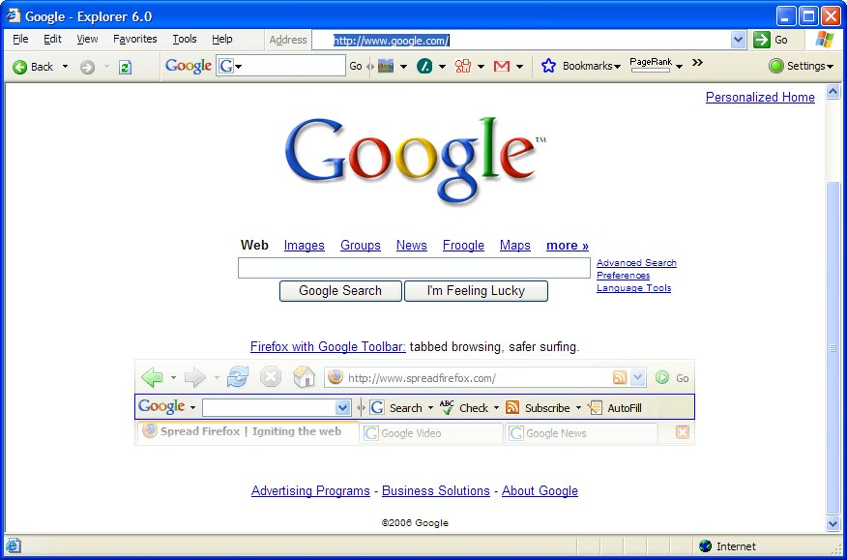
Topic | What I came to know about the given topic from my research?
Gateway | A gateway is a hardware device that acts as a "gate" between two networks. It may be a router, firewall, server, or other device that enables traffic to flow in and out of the network. A router is a common type of gateway used in home networks. It allows computers within the local network to send and receive data over the Internet. A proxy server is another type of gateway that uses a combination of hardware and software to filter traffic between two networks.
Homepage | A home page is a webpage that serves as the starting point of website. It is the default webpage that loads when you visit a web address that only contains a domain name. The home page is located in the root directory of a website. Most web server allow the home page to have one of several different filenames. Examples home page include index.html, index.htm, index.shtml, index.php, default.html, and home.html. The default filename of a website's home page can be customized on both Apache and IIS servers.
Spam | Spam is electronic junk mail or junk newsgroup postings. Spam is generally unsolicited email. However, if a long-lost brother finds your email address and sends you a message, this could hardly be called spam, even though it is unsolicited. Real spam is generally email advertising for some product sent to a mailing list or newsgroup. Phishing, is a type of email scam that is used to fraudulently obtain personal information or details of your online accounts.
Fig: Gateway Fig: Homepage of Google.com

Slide 8
Topic | What I came to know about the given topic from my research?
Unzip | Unzip is the process of extracting the file using utility software such as WinZip, PkunZip or 7-Zip. For example, many of the programs available for download are compressed into one small file making, facilitating faster data transmission. If the downloaded file ends with the .zip extension, it must be unzipped before it can be installed.
Code | It is the term that is used for both statements written in particular programming language. Code is often used generally to mean any kind of concealed writing, including ciphers. "Breaking the code" usually means the discovery of a way to read one or a series of encrypted messages without being given the key to decrypt them.
Decode | Decoding is the process of converting code into plain text or any format that is useful for subsequent processes. Decoding is the reverse of encoding. It converts encoded data communication transmissions and files to their original states. Decoder is a device or program that translates encoded data into its original format. War field flying robot with a night vision flying camera. Robotic vehicle with the metal detector. Automatic health monitoring systems uses usually decoder.

Slide 9
Topic | What I came to know about the given topic from my research?
GIF (Graphic Interchange Format) | It is the computer file format for the compression and storage of visual digital information. It is usually use as the extension for images or videos. The format supports up to 8 bits per pixel for each image, allowing a single image to reference its own palette of up to 256 different colors chosen from the 24-bit RGB color space. It also supports animations and allows a separate palette of up to 256 colors for each frame. These palette limitations make GIF less suitable for reproducing color photographs and other images with color gradients, but it is well-suited for simpler images such as graphics or logos with solid areas of color.
PNG (Portable Network Graphic) | PNG (Portable Network Graphics) is a file format used for lossless image compression. By this format color can be made transparent, the degree of transparency called opacity can be controlled. Images can be saved using true color as well as in the palette and grayscale formats provided by the GIF.
URL (Uniform Resource Locator) | A URL is the address of a specific webpage or file on the Internet. For example, the URL of the Google website is http://www.google.com. URL shows the protocol used to access the location, the server name or IP of the server and also the path to the directory of the file.

Slide 10
Topic | What I came to know about the given topic from my research?
Pixels | A pixel is the smallest unit of a digital image or graphic that can be displayed and represented on a digital display device. A pixel is the basic logical unit in digital graphics. Pixels are combined to form a complete image, video, text or any visible thing on a computer display. A pixel is also known as a picture element.
Resolution | Resolution is the number of pixels (individual points of color) contained on a display monitor, expressed in terms of the number of pixels on the horizontal axis and the number on the vertical axis. The sharpness of the image on a display depends on the resolution and the size of the monitor.
Color Value | A color value is actually a shade of lightness. IT professionals or others might use the terms “lightness” and “color value” interchangeably. Color values are often presented in a chart or graph to help developers or others to choose from various specific shades of color for the purposes of applying to visual projects. A color value scale starts with light and ends with dark. Other categories in between might include light/medium, medium and medium/dark.

Slide 11
Topic | What I came to know about the given topic from my research?
Arduino | Arduino refers to an open-source electronics platform or board and the software used to program it. Arduino is designed to make electronics more accessible to artists, designers, hobbyists and anyone interested in creating interactive objects or environments. An Arduino board can be purchased pre-assembled or, because the hardware design is open source, built by hand. Either way, users can adapt the boards to their needs, as well as update and distribute their own versions. Google Android Open Accessory Development Kit is also based on Arduino.
AutoCAD | AutoCAD is a computer-aided design (CAD) program used for 2-D and 3-D design and drafting. AutoCAD is developed and marketed by Autodesk Inc. and was one of the first CAD programs that could be executed on personal computers. DWG (drawing) is the native file format for AutoCAD and a basic standard for CAD data interoperability. The software has also provided support for Design Web Format (DWF).
Corel Draw | Corel Corporation developed and released a software program called CorelDRAW, a vector graphics editor. The software is a robust graphics suite, providing many features for users to edit graphics. These features include contrast adjustment, color balancing, adding special effects like borders to images, and it is capable of working with multiple layers and multiple pages.

Slide 12
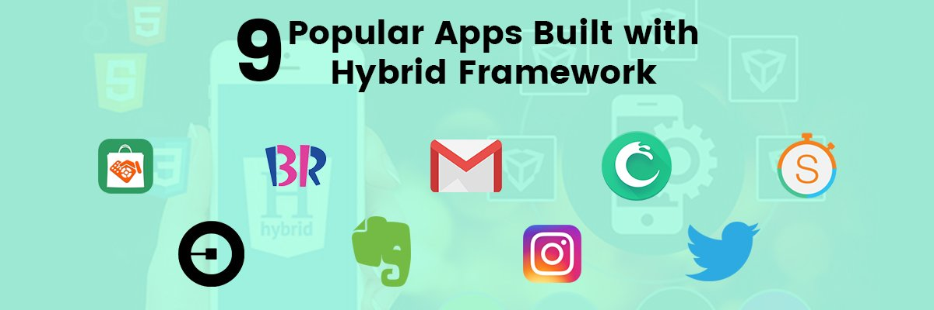
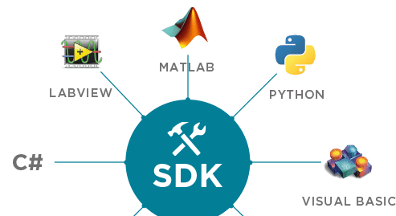
Topic | What I came to know about the given topic from my research?
Hybrid App | In general hybrid apps are built for mobile or known as mobile apps specially featured as an alternative way to native app. It is build by using the html, java or css . PhoneGap, ionic, native script and react native. Excluding react native, are the supportive to develop the hybrid app
Software Developer Kit (SDK) | It’s a set of software tools and programs used by developers to create applications for specific platforms. It is known as software developer kit. Easy to use by other developers Thorough documentation to explain how your code works Enough functionality so it adds value to other apps
Fig: Hyrid App Fig: Software Development Kit (SDK)

Slide 13
Topic | What I came to know about the given topic from my research?
ACCESS | The Microsoft access is similar to the other Microsoft programs but what makes it different from other applications is a database. It is used for database system. The components that are used in Access are as follows: Tables Relationships Queries Forms Reports Macros Modules
SQL (Structured Query Language) | Sql is a language that uses for communicate with database. It speaks only specific language with relational database. Which is essentially a database that has a tabular schema. Sql statements are used to perform tasks such as update data on a database, or retrieve data from a database. Some common relational database management systems that use sql are: oracle, Sybase, Microsoft SQL server, access, ingress, etc.
ORACLE | An oracle database is a collection of data treated as a unit. The purpose of a database is to store and retrieve related information. A database server is the key to solving the problems of information management. The database has logical structures and physical structures.

Slide 14
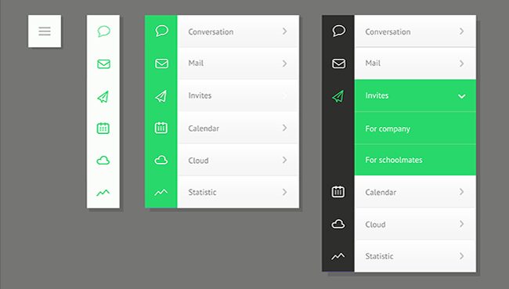
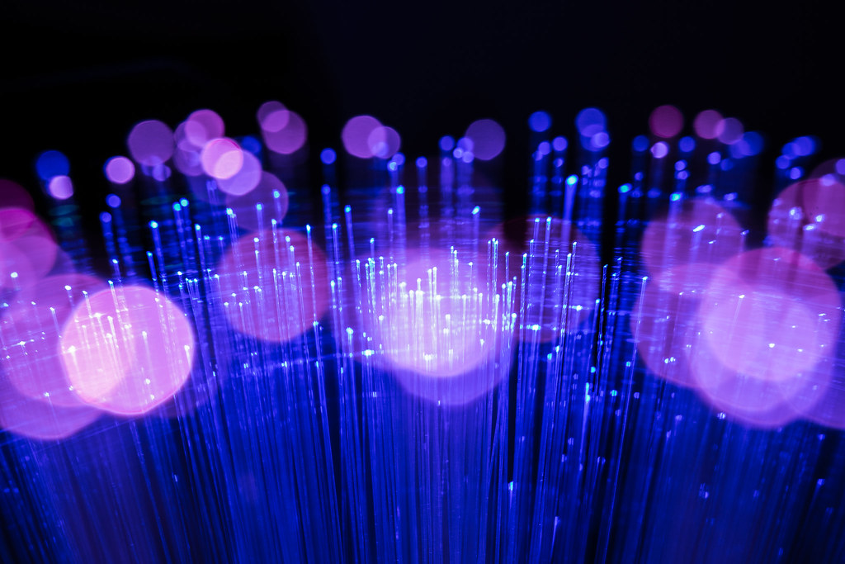
Topic | What I came to know about the given topic from my research?
Navigate | Navigation is the field of study that focuses on the controlling or monitoring the movement of vehicle, ship, aircraft etc. On journey, to follow a planned course. The field of navigation includes four general categories; land, aeronautic ,marine and navigation. In general navigation is the skill or knowledge that includes the determination of position or the direction.
Fiber Optic | It was originally developed for endoscopes in the 1950s to help doctors see inside the human body without having to cut it open first. In the 1960s, engineers found a way of using the same technology to transmit telephone calls at the speed of light (normally that's 186,000 miles or 300,000 km per second in a vacuum, but slows to about two thirds this speed in a fiber-optic cable). Cellphones work a different way: they send and receive information using invisible radio waves a technology called wireless because it uses no cables. Fiber optics works a third way. It sends information coded in a beam of light down a glass or plastic pipe.
Fig: Navigate Fig: Fiber Optic

Slide 15
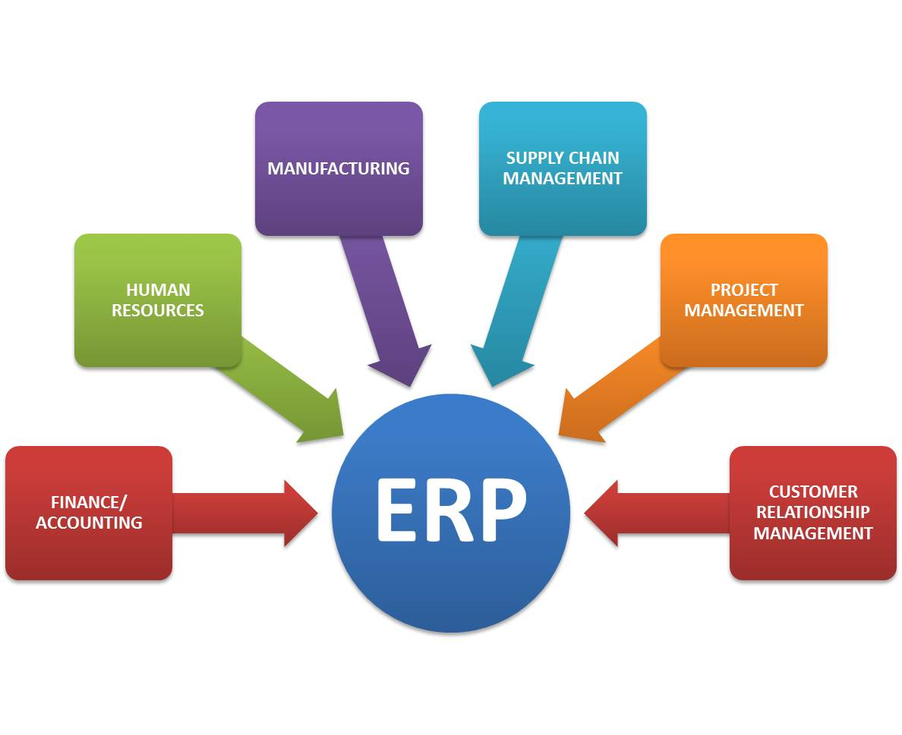
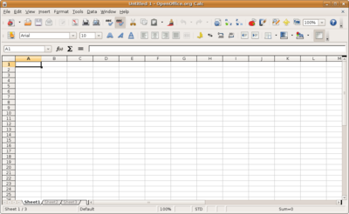
Topic | What I came to know about the given topic from my research?
Spreadsheet | Spread sheet is a worksheet which is made of rows and columns which specially made for short data, arrange data's or calculate the numerical data's also. The spread sheet is a software program because of its ability to calculate the numerical data with the formulas and the data cells which is absolute. The good example of spread sheets utilization is to understand how it make a overview of a bank account.
Enterprise Resource Planning (ERP) | Enterprise Resource Planning (ERP) is a process used by companies to manage and integrate the important parts of their businesses. ERP software system are made to implementation of the business and managing as per their requirement. Many companies are benefited by using the ERP software system as per their need and financial capacity. ERP software system can also integrate planning, purchasing inventory, sales, marketing, finance, human resources, and more.
Fig: Spread Sheet Fig: ERP

Slide 16
Topic | What I came to know about the given topic from my research?
Logger Pro | Data-collection and analysis software for windows and mac computers. It was first launched as temperature sensor, graph, data and meter. Self-guided tutorials. Write labs in logger pro or export data to word or excel. Develop your own experiment files to match your curriculum Made up specially to make data collection
Lan School | Cross platform support for windows, macos, chrome OS, ios, and android operating systems, Thumbnail view allows teachers to view each pupil's screen, Detail view allows teachers to see detailed information on each pupil's session/history, Keystroke monitoring (if enabled by the school) can report on weeks of pupil use with actual keystroke history, Screen snapshot capability allows teachers to document screen, user, time, date, and other information, Internet history shows a list of websites visited by a user, and Running programs view shows all programs running on a pupil's machine, even if minimized. Whitelisting and blacklisting of websites/programs

Slide 17
What is Back-end
There is portion o f the application the user sees and then in most cases the largest part of the application remains unseen. this is the elusive and mystical back-end.
In the web development world, most back-end developers concern themselves with building the actual logic behind the application they are working on.

Slide 18
Bandwidth
Bandwidth is defined as a range within a band of frequencies or wavelengths. Bandwidth is also the amount of data that can be transmitted in a fixed amount of time.
The Bandwidth is particularly important fo I/o devices. For example, a fast disk drive can be hampered by a bus with a low bandwidth.

Slide 19
Booting/re-boot
In computing, booting is the process of starting a computer. It can be initiated by hardware such a button press, or by a software command.
After it is switched on, a computer’s central processing unit has no software in its main memory, so some process must load software into memory before it can be executed.
In computing, rebooting is the process by which a running computer system is restarted, either intentionally or unintentionally.

Slide 20
Bounce Back
Bounce-Back ultimate instant recovery software enables you to back up your entire PC of laptop hard drive, including the operating system, data files, applications, pictures, video, financial documents and settings. Using our patent pending instant PC recovery mode, you can start your PC of laptop directly from an external USB backup hard drive in the event of an operating system malfunction or even a failed hard drive.

Slide 21
Broadband
A high-capacity transmission technique using a wide range of frequencies which enables a large number of messages to be communicated simultaneously.
By using a broadband high-speed internet connection with data transmission rates many times faster than a 56k modern, users can view video of download software and other data-rich files in a matter of seconds.
In addition to offering speed, broadband access provides a continuous “always on” connection and a “two way” capability – that is the ability to both receive and transmit data at high speeds.

Slide 22
VPN (Virtual Private Network)
A VPN is a service that you sign up for online for a small monthly charge
Once you have an account, your VPN service should be "on" when you're online
A VPN, in action, takes your Internet connection and makes it more secure, helps you stay anonymous and helps you get around blocks and access censored sites.
The key to a VPN is that it lends you a temporary IP address and hides your true IP address from every website or email you connect with

Slide 23
Cloud Computing
Cloud computing is a style of computing where massively scalable IT-related capabilities are provides as a service across the internet to multiple external customers.
Cloud computing is internet based technology that enables small business and organizations to use highly sophisticated computer applications.

Slide 24
Topic | What I came to know about the given topic from my research?
Compression | It is used to reduce the size of one or more files. It is often used to save disk space and reduce the time needed to transfer file over the internet. Compressed file can be transferred to other system more quickly.
Bluetooth | Wireless technology Device for exchanging data between fixed and mobile devices over short distance, such as personal digital assistants, mobile phones, laptops, computers, printers and digital cameras via secure, low cost, globally available short range radio frequency band. It can be used in many different products by many different manufactures. It is based on ad-hoc technology. When a group of two or more Bluetooth devices are sharing information together, they form a kind of ad hoc ,mini computer network

Slide 25
Topic | What I came to know about the given topic from my research?
Compression | It is used to reduce the size of one or more files. It is often used to save disk space and reduce the time needed to transfer file over the internet. Compressed file can be transferred to other system more quickly.
Bluetooth | Wireless technology Device for exchanging data between fixed and mobile devices over short distance, such as personal digital assistants, mobile phones, laptops, computers, printers and digital cameras via secure, low cost, globally available short range radio frequency band. It can be used in many different products by many different manufactures. It is based on ad-hoc technology. When a group of two or more Bluetooth devices are sharing information together, they form a kind of ad hoc ,mini computer network

Slide 26
Topic | What I came to know about the given topic from my research?
Malware | It may be File or code. It provides remote control for an attacker to use an infected machine. It sends spam from the infected machine to unsuspecting targets. Investigate the infected user’s local network. It helps hacker to steal sensitive data.
ISP (Internet Service Provider) | An Internet service provider (ISP) is an organization that provides services for accessing, using, or participating in the Internet. Internet services typically provided by ISPs include Internet access, Internet transit, domain name registration, web hosting, Usenet service, and colocation.

Slide 27
Topic | What I came to know about the given topic from my research?
Virus | A computer virus is a malicious program that self-replicates by copying itself to another program. The purpose of creating a computer virus is to infect vulnerable systems, gain admin control and steal user sensitive data. Hackers design computer viruses with malicious intent and prey on online users by tricking them. Virus is one type of malware that inserts its virus code to multiply itself by altering the programs and applications. Types of virus:- Boot Sector Virus, Direct Action Virus, Resident Virus, Multipartite Virus, Polymorphic Virus, Overwrite Virus and Spacefiller Virus.
Virtual | In general, it distinguishes something that is merely conceptual from something that has physical reality. For example, virtual memory refers to an imaginary set of locations, or addresses, where you can store data. It is imaginary in the sense that the memory area is not the same as the real physical memory composed of transistors.

Slide 28
Topic | What I came to know about the given topic from my research?
Server | Server is a computer program or a device that provides functionality for other programs or devices, called "clients". Web server software can run on any capable computer, and so a laptop or a personal computer can host a web server. The purpose of a server is to share data as well as to share resources and distribute work.
Mail-Server | A mail server is a server that handles and delivers e-mail over a network, usually over the Internet. A mail server can receive e-mails from client computers and deliver them to other mail servers. Mail servers can be broken down into two main categories: outgoing mail servers and incoming mail servers.

Slide 29

Domain
When referring to an Internet address or name, a domain or domain name is the location of a website. For example, the domain name "google.com" points to the IP address "216.58.216.164".
The first Internet domain name "symbolics.com“.
A domain name can be a maximum of sixty three characters with one character minimum, and is entered after the protocol in the URL.
This Domain names are used in URLs to identify the particular Web Pages.

Slide 30
Panopto
Panopto is a software tool to capture recordings of ‘video streaming’, audio, power point and the components of the screenshot to create presentations where users can search, reference and review their recordings from anywhere.
Recordings also allow users to upload related pdf files to complement the information that is being delivered in their recordings.
Panopto focus is a flexible and easy-to-use capture presentation platform that allows users to capture, modify, transmit, store and share recordings that preserve critical knowledge.
It is easy to use and flexible.

Slide 31
Topic | What I came to know about the given topic from my research?
Premise Application Software | With this type of implementation, you are responsible for everything related to the running of the software. It must be purchase the network infrastructure, power, servers, operating system, database software, etc. It also need to maintain all of this to keep it running, safe and up to date.
Hosted Application Software | Like on-premises, purchase licenses to use the software from a vendor, but rather than purchasing all of the hardware and infrastructure, rental can be done from the vendor or another third-party provider. It is remotely-hosted, but still own the software purchased.

Slide 32
Data Visualization
Data visualization is the technique of creating the images, diagram or animation to deliver the message.
Data visualization helps two make the comparison between two or more points and data.
Data visualization can be created by using line graphs, histogram, pie charts and others which shows the exact flow of the information by which everyone can know about what is going on.

Slide 33
Machine Bias
Machine bias is the effect of erroneous assumptions in machine learning processes.
Bias reflects problems related to the gathering or use of data, where systems draw improper conclusions about data sets, either because of human intervention or as a result of a lack of cognitive assessment of data.
It is also known as algorithm bias or simply bias.

Slide 34
Big Data
Big data refers to the large, diverse sets of information that grow at ever-increasing rates.
It encompasses the volume of information, the velocity or speed at which it is created and collected, and the variety or scope of the data points being covered.
Big data often comes from multiple sources and arrives in multiple formats.

Slide 35
RDMS (Relational Database Management System)
A relational database refers to a database that stores data in a structured format, using rows and columns.
It makes easy to locate and access specific values within the database.
It is "relational" because the values within each table are related to each other.
Tables may also be related to other tables. The relational structure makes it possible to run queries across multiple tables at once.
Examples: MySQL, Microsoft SQL Server, and IBM DB2.

Slide 36
Net Surfing
Net Surfing is a term typically used to describe an undirected type of web of browsing where users whimsically follow one interesting link to another without a planned search strategy or definite objective.
Surfing the net has become a popular pastime, for many Internet users.
Many users are hooked on it, spending countless hours doing casual searches or other online activities.

Slide 37
Topic | What I came to know about the given topic from my research?
Junk Mail | It is an unsolicited mail sent out usually by direct marketing or direct mail firms. It is used mainly for introducing new products, books and magazines, investment opportunities, merchandise catalogs, etc., junk mail is big business in industrialized sector.
Ip Address | An IP address is a unique address that identifies a device on the Internet or a local network. It allows a system to be recognized by other systems connected via the Internet protocol. There are two primary types of IP address formats used today IPv4 and IPv6.

Slide 38
Topic | What I came to know about the given topic from my research?
A.I | Artificial intelligence (AI), the ability of a digital computer to perform tasks commonly associated with intelligent beings. The term is frequently applied to the project of developing systems endowed with the intellectual processes characteristic of humans, such as the ability to reason, discover meaning, generalize, or learn from past experience. Example of AI: SIRI , Netflix etc
Cyber Attack | Cyber attack is an assault launched by cybercriminals using one or more computers against a single or multiple computers or networks. A cyber attack can maliciously disable computers, steal data, or use a breached computer as a launch point for other attacks. Cybercriminals use a variety of methods to launch a cyber attack, including malware, phishing, ransomware, denial of service, among other methods.

Slide 39
Topic | What I came to know about the given topic from my research?
Encrypt | Encryption is the process of converting data to an unrecognizable or "encrypted" form. It is commonly used to protect sensitive information so that only authorized parties can view it. This includes files and storage devices, as well as data transferred over wireless networks and the Internet. The application that are used for encryption are: GnuPg, AxCrypt, 7-zip etc.
Open-Source | A software for which the original source code is made freely available and may be redistributed and modified according to the requirement of the user. Open source software is that by which the source code or the base code is usually available for modification or enhancement by anyone for reusability and accessibility. Open source code is the part of software that mostly users don't ever see. Anyone can manipulate and change a piece of software so that the program or application can work. Linux, Arduino are the common examples of open source software.

Slide 40
Topic | What I came to know about the given topic from my research?
User Interface | A user interface, is a interface in which a person controls a software application or hardware device. A good user interface provides a "user-friendly" experience, allowing the user to interact with the software or hardware in a natural and intuitive way. Examples: Graphic user Interface( GUI), word processor, web browsers etc.
Font | A font is a graphical representation of text that may include a different typeface, point size, weight, color, or design. Software programs like Microsoft Word, Microsoft Excel, and WordPad allow users to change the font used when typing text in the document or spreadsheet, as do web designers.

Slide 41
Topic | What I came to know about the given topic from my research?
GUI (Graphic User Interface) | It is a user interface that includes graphical elements, such as windows, icons and buttons. The term was created in the 1970s to distinguish graphical interfaces from text-based ones, such as command line interfaces. Nowadays nearly all digital interfaces are GUIs. Example: Windows, Android etc.
USER | A user is a person who utilizes a computer or network service. Users of computer systems and software products generally lack the technical expertise required to fully understand how they work. A user often has a user account and is identified to the system by a username (or user name).

Slide 42
Thank You

